Slide 1




Faith without works is dead?
Explaining the first works [Rev 2:5 NKJV] 5 "Remember therefore from where you have fallen; repent and do the first works, or else I will come to you quickly and remove your lampstand from its place--unless you repent.

Slide 2

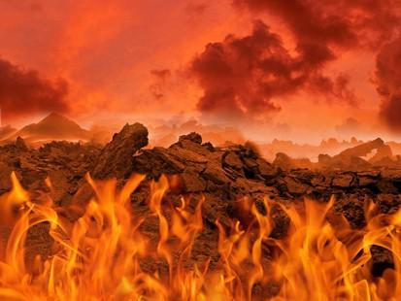

How I broke free of my bondage to Pornography, through the fear of God.
[Jde 1:21-23 NKJV] 21 keep yourselves in the love of God, looking for the mercy of our Lord Jesus Christ unto eternal life. 22 And on some have compassion, making a distinction; 23 but others save with fear, pulling [them] out of the fire, hating even the garment defiled by the flesh.
[Heb 10:26-31 NKJV] 26 For if we sin willfully after we have received the knowledge of the truth, there no longer remains a sacrifice for sins, 27 but a certain fearful expectation of judgment, and fiery indignation which will devour the adversaries. 28 Anyone who has rejected Moses' law dies without mercy on [the testimony of] two or three witnesses. 29 Of how much worse punishment, do you suppose, will he be thought worthy who has trampled the Son of God underfoot, counted the blood of the covenant by which he was sanctified a common thing, and insulted the Spirit of grace? 30 For we know Him who said, "Vengeance is Mine, I will repay," says the Lord. And again, "The LORD will judge His people." 31 It is a fearful thing to fall into the hands of the living God.

Slide 3

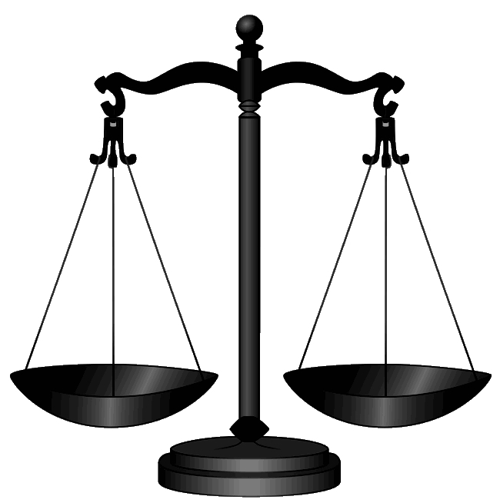



Let’s rewind – What is faith and what are the works of the law?
[Gal 5:19-21 NKJV] 19 Now the works of the flesh are evident, which are: adultery, fornication, uncleanness, lewdness, 20 idolatry, sorcery, hatred, contentions, jealousies, outbursts of wrath, selfish ambitions, dissensions, heresies, 21 envy, murders, drunkenness, revelries, and the like; of which I tell you beforehand, just as I also told [you] in time past, that those who practice such things will NOT inherit the kingdom of God.
[Heb 11:1 NKJV] 1 Now faith is the substance of things hoped for, the evidence of things not seen.
[Gal 5:22-24 NKJV] 22 But the fruit of the Spirit is love, joy, peace, longsuffering, kindness, goodness, faithfulness, 23 gentleness, self-control. Against such there is NO law. 24 And those [who are] Christ's have crucified the flesh with its passions and desires.

Slide 4
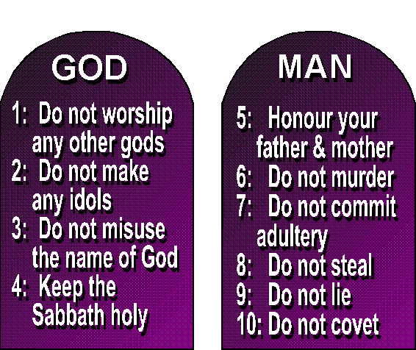

The Commandments
If we are under grace (purifying our hearts and breaking free of sin) we are not under the law. If we sin, we are under the law.
[1Jo 3:4 NKJV] 4 Whoever commits sin also commits lawlessness, and sin is lawlessness.
[Mat 22:36-40 NKJV] 36 "Teacher, which [is] the great commandment in the law?" 37 Jesus said to him, "'You shall love the LORD your God with all your heart, with all your soul, and with all your mind.' 38 "This is [the] first and great commandment. 39 "And [the] second [is] like it: 'You shall love your neighbor as yourself.' 40 "On these two commandments hang all the Law and the Prophets."
[Rom 6:1-2 NKJV] 1 What shall we say then? Shall we continue in sin that grace may abound? 2 Certainly not! How shall we who died to sin live any longer in it?
[Rom 6:12-16 NKJV] 12 Therefore do not let sin reign in your mortal body, that you should obey it in its lusts. 13 And do not present your members [as] instruments of unrighteousness to sin, but present yourselves to God as being alive from the dead, and your members [as] instruments of righteousness to God. 14 For sin shall not have dominion over you, for you are not under law but under grace. 15 What then? Shall we sin because we are not under law but under grace? Certainly not! 16 Do you not know that to whom you present yourselves slaves to obey, you are that one's slaves whom you obey, whether of sin [leading] to death, or of obedience [leading] to righteousness?
[Rom 3:28-31 NKJV] 28 Therefore we conclude that a man is justified by faith apart from the deeds of the law. 29 Or [is He] the God of the Jews only? [Is He] not also the God of the Gentiles? Yes, of the Gentiles also, 30 since [there is] one God who will justify the circumcised by faith and the uncircumcised through faith. 31 Do we then make void the law through faith? Certainly not! On the contrary, we establish the law.

Slide 5
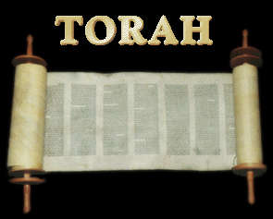

Aren’t our works like dirty rags? Pt 1
If you try to obtain righteousness through the works (deeds) of the Law, they are the dirty rags spoken of. Paul explains below the works of the Law.
[Col 2:14-23 NKJV] 14 having wiped out the handwriting of requirements that was against us, which was contrary to us. And He has taken it out of the way, having nailed it to the cross. 15 Having disarmed principalities and powers, He made a public spectacle of them, triumphing over them in it. 16 So let no one judge you in food or in drink, or regarding a festival or a new moon or sabbaths, 17 which are a shadow of things to come, but the substance is of Christ. 18 Let no one cheat you of your reward, taking delight in [false] humility and worship of angels, intruding into those things which he has not seen, vainly puffed up by his fleshly mind, 19 and not holding fast to the Head, from whom all the body, nourished and knit together by joints and ligaments, grows with the increase [that is] from God. 20 Therefore, if you died with Christ from the basic principles of the world, why, as [though] living in the world, do you subject yourselves to regulations-- 21 "Do not touch, do not taste, do not handle," 22 which all concern things which perish with the using--according to the commandments and doctrines of men? 23 These things indeed have an appearance of wisdom in self-imposed religion, [false] humility, and neglect of the body, [but are] of no value against the indulgence of the flesh.

Slide 6
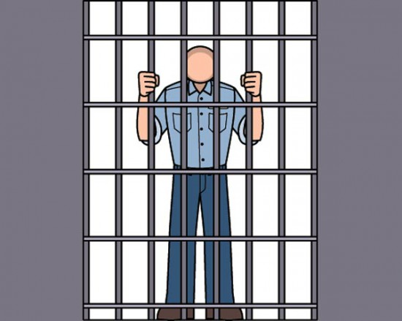
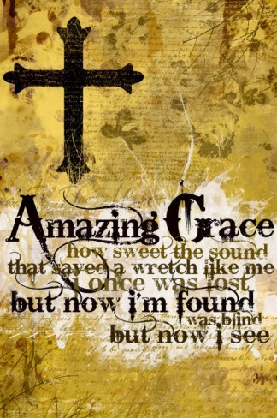

Aren’t our works like dirty rags? Pt 2
True faith produces works that are from God. (Eph 2:10) We can never become righteous by following the law.
[Gal 5:6 NKJV] 6 For in Christ Jesus neither circumcision nor uncircumcision avails anything, but faith working through love.
[Gal 6:15 NKJV] 15 For in Christ Jesus neither circumcision nor uncircumcision avails anything, but a new creation.
[Rom 4:2-6 NKJV] 2 For if Abraham was justified by works, he has [something] to boast about, but not before God. 3 For what does the Scripture say? "Abraham believed God, and it was accounted to him for righteousness." 4 Now to him who works, the wages are not counted as grace but as debt. 5 But to him who does not work but believes on Him who justifies the ungodly, his faith is accounted for righteousness, 6 just as David also describes the blessedness of the man to whom God imputes righteousness apart from works:
[Gal 5:3-4 NKJV] 3 And I testify again to every man who becomes circumcised that he is a debtor to keep the whole law. 4 You have become estranged from Christ, you who [attempt to] be justified by law; you have fallen from grace.
[Rom 11:6 NKJV] 6 And if by grace, then [it is] no longer of works; otherwise grace is no longer grace. But if [it is] of works, it is no longer grace; otherwise work is no longer work.

Slide 7



Explaining the choice.
[Jas 1:15-16 NKJV] 15 Then, when desire has conceived, it gives birth to sin; and sin, when it is full-grown, brings forth death. 16 Do not be deceived, my beloved brethren.
Sin
Desire
[Jas 1:14 NKJV] 14 But each one is tempted when he is drawn away by his own desires and enticed.
[Jas 1:12 NKJV] 12 Blessed [is] the man who endures temptation; for when he has been approved, he will receive the crown of life which the Lord has promised to those who love Him.
Obey

Slide 8

Explaining the consequences.
[Jas 2:26 NKJV] 26 For as the body without the spirit is dead, so faith without works is dead also. [Rom 6:23 NKJV] 23 For the wages of sin [is] death, but the gift of God [is] eternal life in Christ Jesus our Lord.
Death
Sin
[Jas 1:15 NKJV] 15 Then, when desire has conceived, it gives birth to sin; and sin, when it is full-grown, brings forth death.
Repent
[Jas 5:19-20 NKJV] 19 Brethren, if anyone among you wanders from the truth, and someone turns him back, 20 let him know that he who turns a sinner from the error of his way will save a soul from death and cover a multitude of sins.

Slide 9
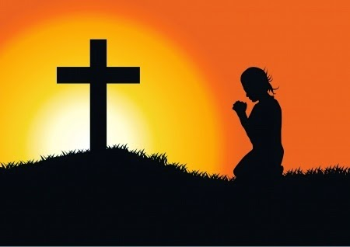


How can we resist sin?
[1Co 10:13-14 NKJV] 13 No temptation has overtaken you except such as is common to man; but God [is] faithful, who will not allow you to be tempted beyond what you are able, but with the temptation will also make the way of escape, that you may be able to bear [it]. 14 Therefore, my beloved, flee from idolatry.
[2Pe 1:4-8 NKJV] 4 by which have been given to us exceedingly great and precious promises, that through these you may be partakers of the divine nature, having escaped the corruption [that is] in the world through lust. 5 But also for this very reason, giving all diligence, add to your faith virtue, to virtue knowledge, 6 to knowledge self-control, to self-control perseverance, to perseverance godliness, 7 to godliness brotherly kindness, and to brotherly kindness love. 8 For if these things are yours and abound, [you] will be neither barren nor unfruitful in the knowledge of our Lord Jesus Christ.

Slide 10
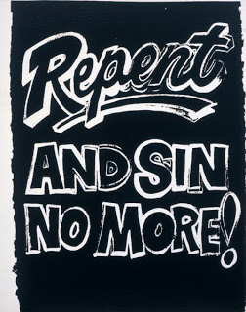
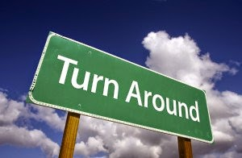

Repentance leads to life (The first works)
Repent of your double-mindedness with Godly sorrow.
[Jas 4:6-10 NKJV] 6 But He gives more grace. Therefore He says: "God resists the proud, But gives grace to the humble." 7 Therefore submit to God. Resist the devil and he will flee from you. 8 Draw near to God and He will draw near to you. Cleanse [your] hands, [you] sinners; and purify [your] hearts, [you] double-minded. 9 Lament and mourn and weep! Let your laughter be turned to mourning and [your] joy to gloom. 10 Humble yourselves in the sight of the Lord, and He will lift you up.
[2Co 7:8-11 NKJV] 8 For even if I made you sorry with my letter, I do not regret it; though I did regret it. For I perceive that the same epistle made you sorry, though only for a while. 9 Now I rejoice, not that you were made sorry, but that your sorrow led to repentance. For you were made sorry in a godly manner, that you might suffer loss from us in nothing. 10 For godly sorrow produces repentance [leading] to salvation, not to be regretted; but the sorrow of the world produces death. 11 For observe this very thing, that you sorrowed in a godly manner: What diligence it produced in you, [what] clearing [of yourselves], [what] indignation, [what] fear, [what] vehement desire, [what] zeal, [what] vindication! In all [things] you proved yourselves to be clear in this matter.

Slide 11



What are your idols?
Smash your idols – I did this by throwing my game system in the garbage.
[Act 19:18-20 NKJV] 18 And many who had believed came confessing and telling their deeds. 19 Also, many of those who had practiced magic brought their books together and burned [them] in the sight of all. And they counted up the value of them, and [it] totaled fifty thousand [pieces] of silver. 20 So the word of the Lord grew mightily and prevailed.
This is How Jesus described destroying our idols.
[Mat 5:29-30 NKJV] 29 "If your right eye causes you to sin, pluck it out and cast [it] from you; for it is more profitable for you that one of your members perish, than for your whole body to be cast into hell. 30 "And if your right hand causes you to sin, cut it off and cast [it] from you; for it is more profitable for you that one of your members perish, than for your whole body to be cast into hell.

Slide 12


Choose this day whom you will serve!
[Jos 24:14-15 NKJV] 14 "Now therefore, fear the LORD, serve Him in sincerity and in truth, and put away the gods which your fathers served on the other side of the River and in Egypt. Serve the LORD! 15 "And if it seems evil to you to serve the LORD, choose for yourselves this day whom you will serve, whether the gods which your fathers served that [were] on the other side of the River, or the gods of the Amorites, in whose land you dwell. But as for me and my house, we will serve the LORD."
[Rom 6:15-18 NKJV] 15 What then? Shall we sin because we are not under law but under grace? Certainly not! 16 Do you not know that to whom you present yourselves slaves to obey, you are that one's slaves whom you obey, whether of sin [leading] to death, or of obedience [leading] to righteousness? 17 But God be thanked that [though] you were slaves of sin, yet you obeyed from the heart that form of doctrine to which you were delivered. 18 And having been set free from sin, you became slaves of righteousness.
As we’ll see in the next slide, Abraham’s obedient faith is what gave him imputed righteousness.

Slide 13


Works by faith, instead of by the law.
[Jas 2:14-26 NKJV] 14 What [does it] profit, my brethren, if someone says he has faith but does not have works? Can faith save him? 15 If a brother or sister is naked and destitute of daily food, 16 and one of you says to them, "Depart in peace, be warmed and filled," but you do not give them the things which are needed for the body, what [does it] profit? 17 Thus also faith by itself, if it does not have works, is dead. 18 But someone will say, "You have faith, and I have works." Show me your faith without your works, and I will show you my faith by my works. 19 You believe that there is one God. You do well. Even the demons believe--and tremble! 20 But do you want to know, O foolish man, that faith without works is dead? 21 Was not Abraham our father justified by works when he offered Isaac his son on the altar? 22 Do you see that faith was working together with his works, and by works, faith was made perfect? 23 And the Scripture was fulfilled which says, "Abraham believed God, and it was accounted to him for righteousness." And he was called the friend of God. 24 You see then that a man is justified by works, and not by faith only. 25 Likewise, was not Rahab the harlot also justified by works when she received the messengers and sent [them] out another way? 26 For as the body without the spirit is dead, so faith without works is dead also.
[2Co 7:1 NKJV] 1 Therefore, having these promises, beloved, let us cleanse ourselves from all filthiness of the flesh and spirit, perfecting holiness in the fear of God.
Abraham was accounted righteous because his faith produced obedience. Abraham feared God.
[Heb 11:8 NKJV] 8 By faith Abraham obeyed when he was called to go out to the place which he would receive as an inheritance. And he went out, not knowing where he was going.

Slide 14
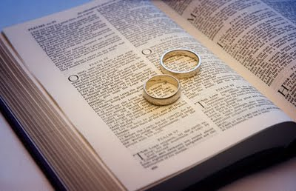
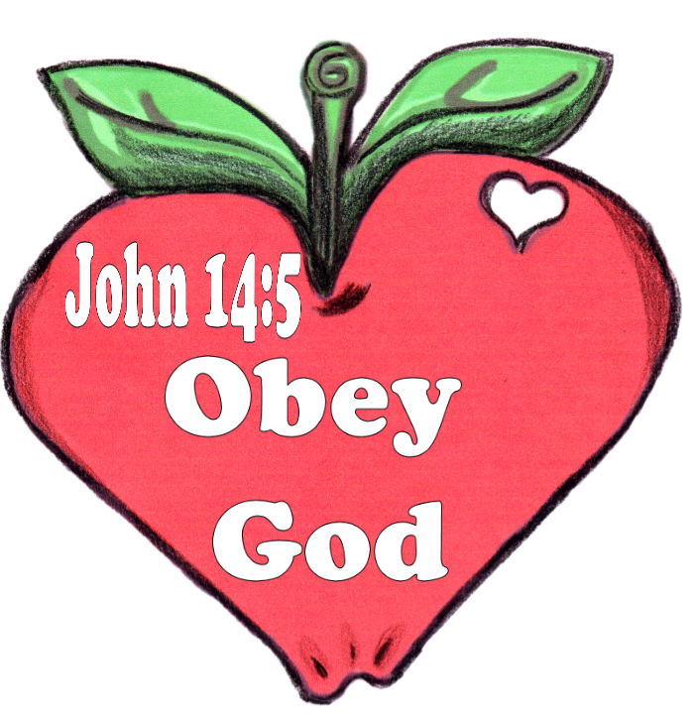

True faith, is more than belief.
As James warned in His famous passage I just quoted, even the Demons believe and fear God. True faith is more than belief. True faith is obedience out of love.
[Jhn 14:15 NKJV] 15 "If you love Me, keep My commandments.
[Eph 5:9-21 NKJV] 9 (for the fruit of the Spirit [is] in all goodness, righteousness, and truth), 10 finding out what is acceptable to the Lord. 11 And have no fellowship with the unfruitful works of darkness, but rather expose [them]. 12 For it is shameful even to speak of those things which are done by them in secret. 13 But all things that are exposed are made manifest by the light, for whatever makes manifest is light. 14 Therefore He says: "Awake, you who sleep, Arise from the dead, And Christ will give you light." 15 See then that you walk circumspectly, not as fools but as wise, 16 redeeming the time, because the days are evil. 17 Therefore do not be unwise, but understand what the will of the Lord [is]. 18 And do not be drunk with wine, in which is dissipation; but be filled with the Spirit, 19 speaking to one another in psalms and hymns and spiritual songs, singing and making melody in your heart to the Lord, 20 giving thanks always for all things to God the Father in the name of our Lord Jesus Christ, 21 submitting to one another in the fear of God.
[1Jo 2:3 NKJV] 3 Now by this we know that we know Him, if we keep His commandments.
[1Jo 2:5-6 NKJV] 5 But whoever keeps His word, truly the love of God is perfected in him. By this we know that we are in Him. 6 He who says he abides in Him ought himself also to walk just as He walked.

Slide 15
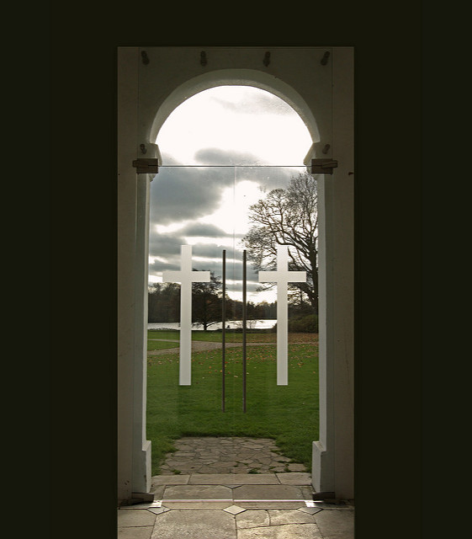
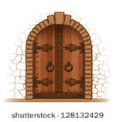
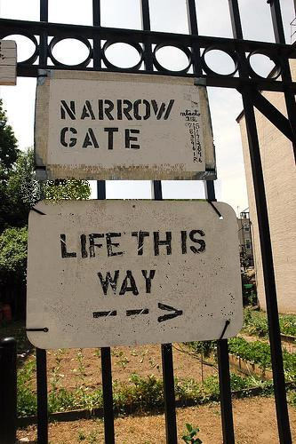

The narrow and difficult path to eternal life
Matt 7:13 “Enter by the narrow gate; for wide is the gate and broad is the way that leads to destruction, and there are many who go in by it. 14 Because narrow is the gate and difficult is the way which leads to life, and there are few who find it.
[Luk 13:23-24 NKJV] 23 Then one said to Him, "Lord, are there few who are saved?" And He said to them, 24 "Strive to enter through the narrow gate, for many, I say to you, will seek to enter and will not be able.
[Luk 13:27 NKJV] 27 "But He will say, 'I tell you I do not know you, where you are from. Depart from Me, all you workers of iniquity.'
Matt 7:19 Every tree that does not bear good fruit is cut down and thrown into the fire.
[Luk 6:46 NKJV] 46 "But why do you call Me 'Lord, Lord,' and not do the things which I say?
[Jhn 14:15 NKJV] 15 "If you love Me, keep My commandments.
BROAD
GATE
Matt 7:23 And then I will declare to them, ‘I never knew you; depart from Me, you who practice lawlessness!’

Slide 16
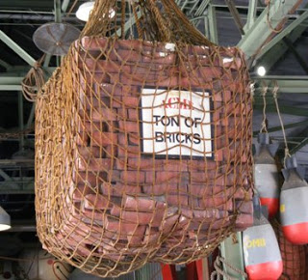
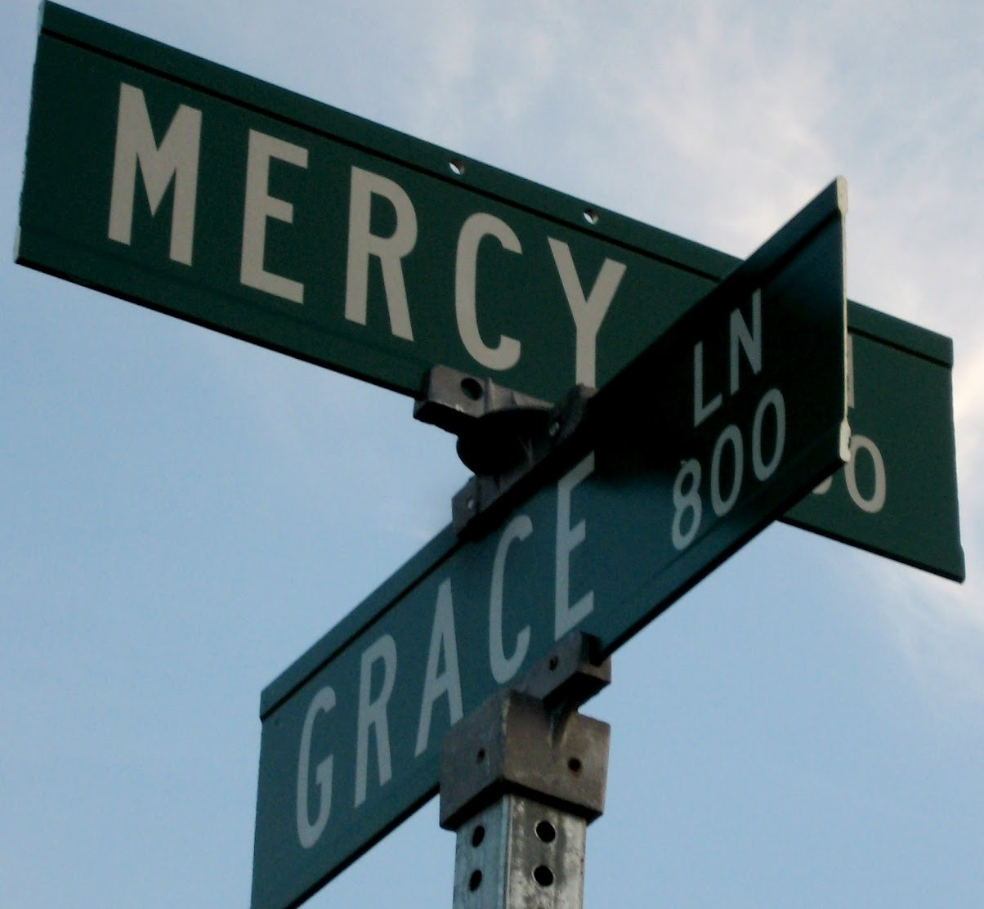

A ton of Bricks!
This teaching I presented is like being hit with a ton of bricks. The Holy Spirit prompted me today to end on a softer note.

Slide 17
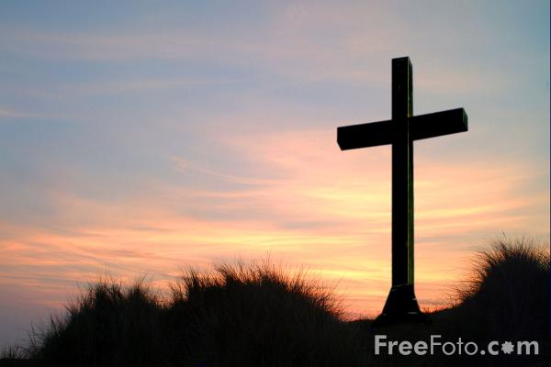

Our Advocate is filled with mercy!
[1Jo 2:1-2 NKJV] 1 My little children, these things I write to you, so that you may not sin. And IF anyone sins, we have an Advocate with the Father, Jesus Christ the righteous. 2 And He Himself is the propitiation for our sins, and not for ours only but also for the whole world.
[Lam 3:22-26 NKJV] 22 [Through] the LORD's mercies we are not consumed, Because His compassions fail not. 23 [They are] new every morning; Great [is] Your faithfulness. 24 "The LORD [is] my portion," says my soul, "Therefore I hope in Him!" 25 The LORD [is] good to those who wait for Him, To the soul [who] seeks Him. 26 [It is] good that [one] should hope and wait quietly For the salvation of the LORD.

